Slide 1
Stream Ciphers
process message bit by bit (as a stream)
have a pseudo random keystream
combined (XOR) with plaintext bit by bit
randomness of stream key completely destroys statistically properties in message
C_{i} = M_{i} XOR StreamKey_{i}
but must never reuse stream key
otherwise can recover messages

Slide 2
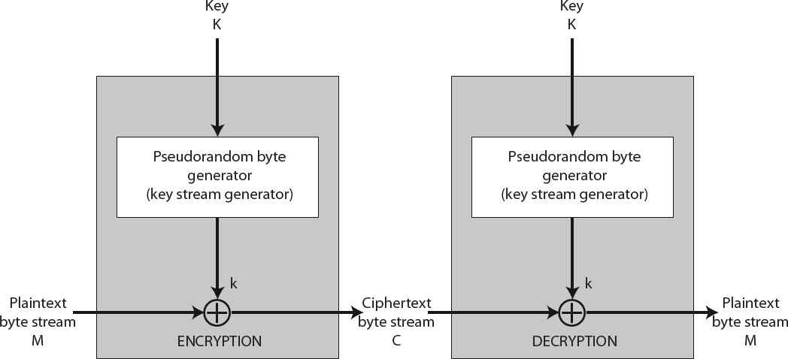
Stream Cipher Structure

Slide 3
RC4- Rivest Cipher
RC4 (Rivest Cipher) is a stream cipher that was designed in 1984 by Ronald Rivest for RSA Data Security.
RC4 is used in many data communication and networking protocols, including SSL/TLS and the IEEE802.11 wireless LAN standard.
RC4 is a byte-oriented stream cipher in which a byte (8 bits) of a plaintext is exclusive-ored with a byte of key to produce a byte of a ciphertext.
The secret key, from which the one-byte keys in the key stream are generated, can contain anywhere from 1 to 256 bytes.

Slide 4
State
RC4 is based on the concept of a state. At each moment, a state of 256 bytes is active, from which one of the bytes is randomly selected to serve as the key for encryption.
The idea can be shown as an array of bytes:
S[0] S[1] S[2] … S[255]
Note that the indices of the elements range between 0 and 255. The contents of each element is also a byte (8 bits) that can be interpreted as an integer between 0 to 255.

Slide 5
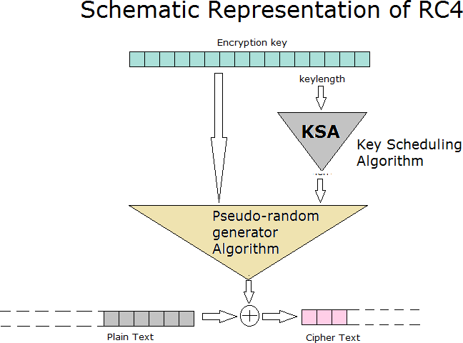

Slide 6
RC4 Key Schedule
Starts with an array S of numbers: 0..255 A temporary vector T is also created
If the length of key K is 256 bytes ,then K is transferred to T
For a key of length ‘ keylen’ bytes, the first keylen elements of T are copied from K & then K is repeated as many times as necessary to fill out T.

Slide 7
Initialization
for i = 0 to 255 do
S[i] | = | i;
T[i] | = | K[i | mod | keylen];
Initial permutation of S
j = 0;
for i = 0 to 255 do
j = (j + S[i] + T[i]) (mod 256)
swap (S[i], S[j])

Slide 8
RC4 Encryption (1)
encryption continues shuffling array values
Stream Generation
i,j = 0;
While (true)
i = |  | (i + | 1) mod 256
j = |  | (j + | S[i]) mod 256
swap(S[i], S[j])
t | = | (S[i] + |  | S[j]) mod 256
K | = | S[t];

Slide 9
RC4 Encryption (2)
To encrypt , XOR the value k with the next byte of plain text.
To decrypt , XOR the value k with the next byte of cipher text

Slide 10
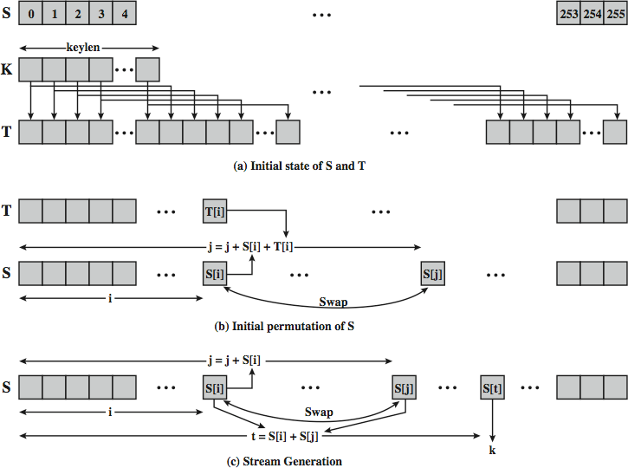
RC4 Overview

Slide 11
RC4 Security
Claimed secure against known attacks
have some analysis, none practical
Result is very non-linear
Since RC4 is a stream cipher, must never reuse a key

Slide 12
RC4
Divided into 2 parts
Key Scheduling Algorithm (KSA)
Pseudo Random Generation Algorithm (PRGA)
Run PRGA on the KSA output to generate Key stream
XOR the data with key stream

